Slide 1


Ruby Language
WEBD 5201 WEB DEVELOPMENT FRAMEWORKS

Slide 2

Assignment 3
Requirement Analysis and Technology Selection for a Stock Trading Platform
Critical thinking and creativity in designing a stock trading platform.

Slide 3

HISTORY
Ruby was created by Yukihiro Matsumoto (often referred to as "Matz") in the mid-1990s in Japan.
It was designed to be a language that emphasizes simplicity and productivity, making it enjoyable for programmers to use.

Slide 4

KEY FEATURE
Object-Oriented: Everything in Ruby is an object, which promotes a clean and consistent syntax.
Dynamic Typing: Ruby is dynamically typed, meaning you don't need to specify variable types.
Garbage Collection: Automatic memory management helps prevent memory leaks.
Open Classes: You can modify existing classes or add new methods to them during runtime.
Metaprogramming: Ruby allows for powerful metaprogramming, enabling code to modify itself.
Blocks and Closures: Blocks of code can be passed around as objects, facilitating elegant solutions to problems.

Slide 5


Slide 6

Ecosystem
The RubyGems package manager and the RubyGems.org repository make it easy to share and distribute Ruby libraries and gems.
Popular web frameworks like Ruby on Rails have made Ruby a preferred choice for web development.

Slide 7

Package Manager
Gems are an integral part of the Ruby ecosystem and provide a way to share and distribute reusable code and libraries.
RubyGems is the package manager for Ruby. It is included with the standard Ruby distribution. RubyGems provides the infrastructure for finding, installing, and managing gems. You can use the gem command to interact with RubyGems.

Slide 8

Use cases
Web Development
Automation
Text and Document processing (NLP)

Slide 9

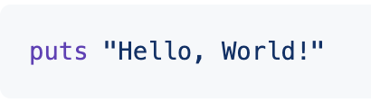
Hello World
You can create a new Ruby script file with a .rb extension, paste this line of code into the file, and then run it using the Ruby interpreter. This will display "Hello, World!" on your terminal or console.

Slide 10
Variable and Datatypes
Numeric:
Integer: Whole numbers, e.g., 5, 100, -42.
Float: Numbers with decimal points, e.g., 3.14, -0.5, 1.0.
String:
A sequence of characters, e.g., "Hello, World!", 'Ruby', "123".
Boolean:
true or false.
Array:
An ordered collection of items, e.g., [1, 2, 3], ['apple', 'banana', 'cherry'].
Hash:
A collection of key-value pairs, e.g., {'name' => 'Alice', 'age' => 30}.
Symbol:
Lightweight, immutable strings often used as keys in hash tables, e.g., :symbol_name.
Nil:
Represents the absence of a value, e.g., nil.

Slide 11
Meta programming
Metaprogramming is a powerful feature of the Ruby programming language. It allows you to write code that can generate or modify other code during runtime. Ruby provides several mechanisms for metaprogramming, including reflection, method_missing, and dynamic class modification.

Slide 12

Blocks
A block is a piece of code enclosed within a { } or do...end statement.
Blocks can be passed to methods as arguments and executed within the method's context.
They are often used for iterating through collections or defining custom behavior within methods.
Blocks can take parameters and are enclosed in pipes (|) to specify the parameters.

Slide 13
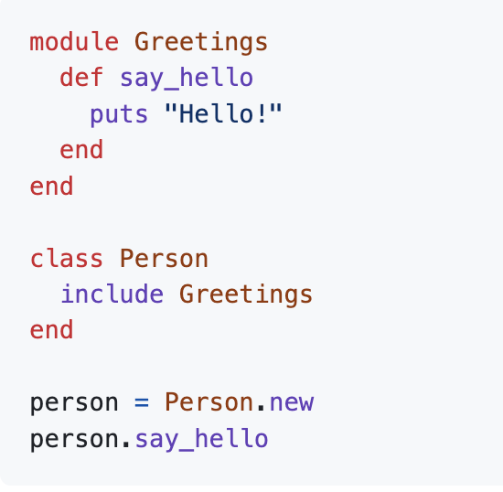
Modules
Modules in Ruby are a way to encapsulate methods, constants, and classes.

Slide 14
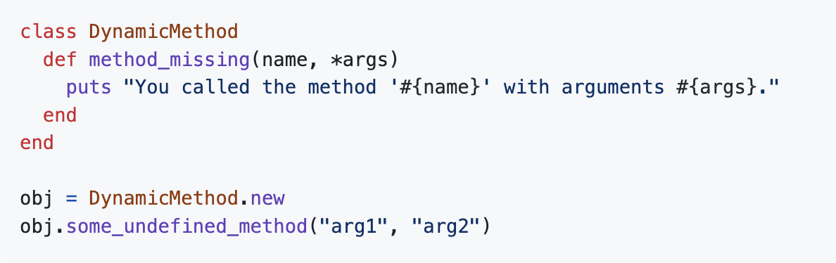
Method Missing
Ruby's method_missing method allows you to intercept and handle calls to undefined methods in an object.

Slide 15
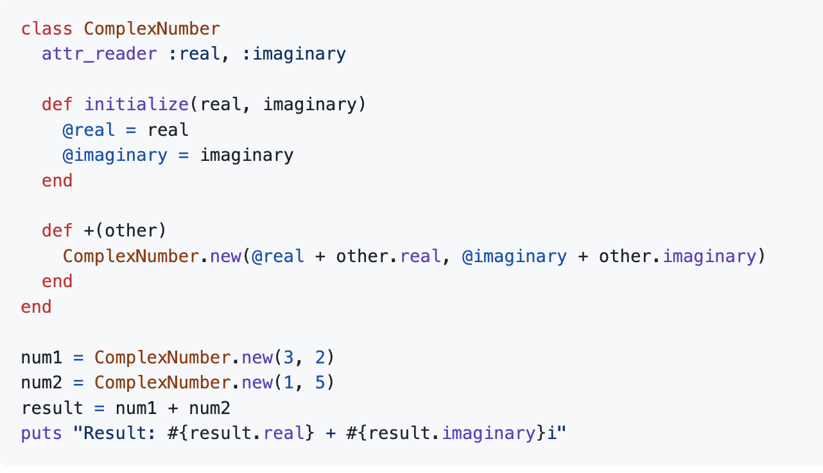
Operator Overloading
Operator overloading in Ruby allows you to redefine or customize the behavior of operators for your custom classes.

Slide 16
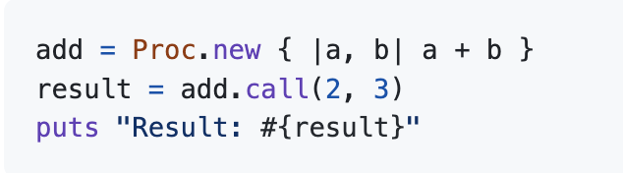
Procs and Lambdas
Procs and lambdas are objects that represent blocks of code. They can be stored in variables and passed as arguments to methods.

Slide 17
Activity
https://github.com/spkdroid/Ruby-Tutorial/

